Slide 1
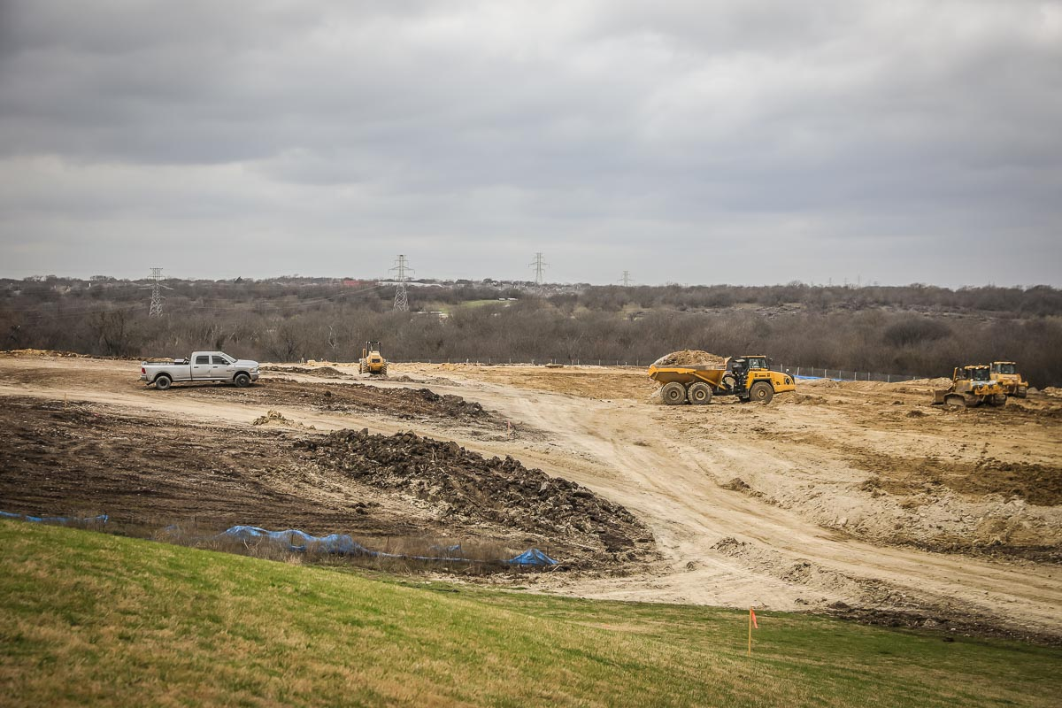
NEW ADMINISTRATION BUILDING
The photo shows the site development view from Marine Creek MS showing relocation of soils to level the site.

Slide 2
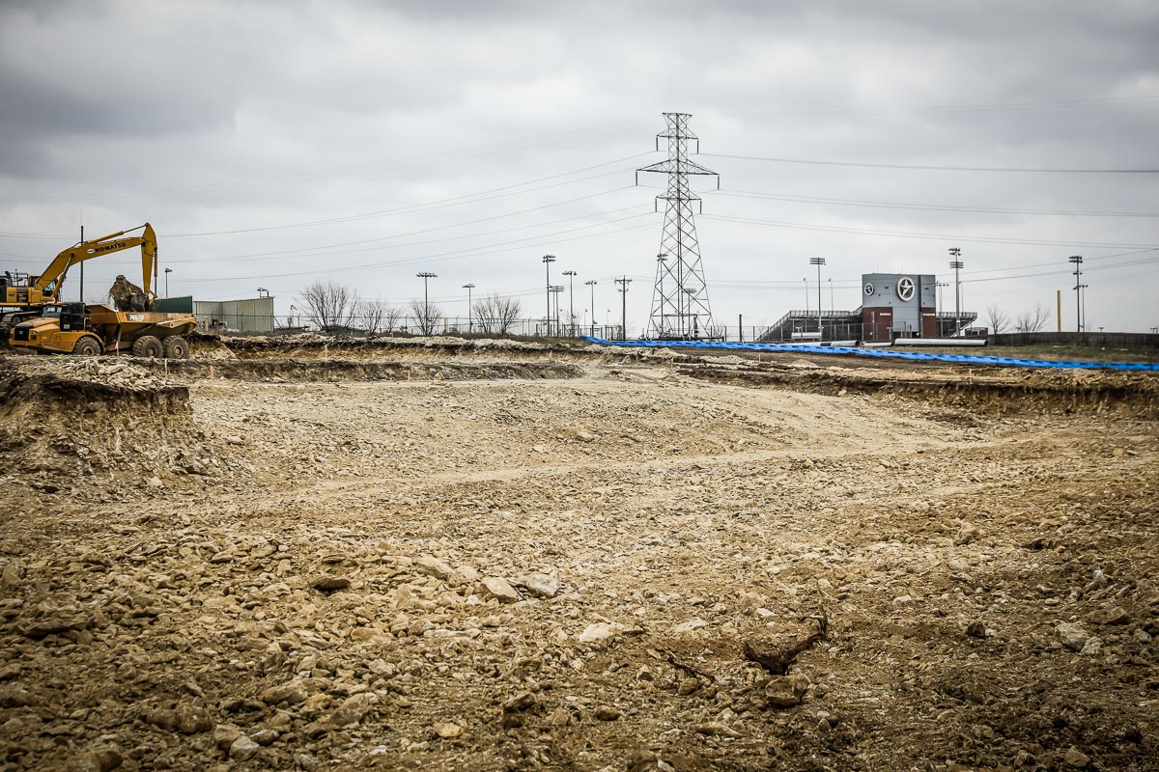
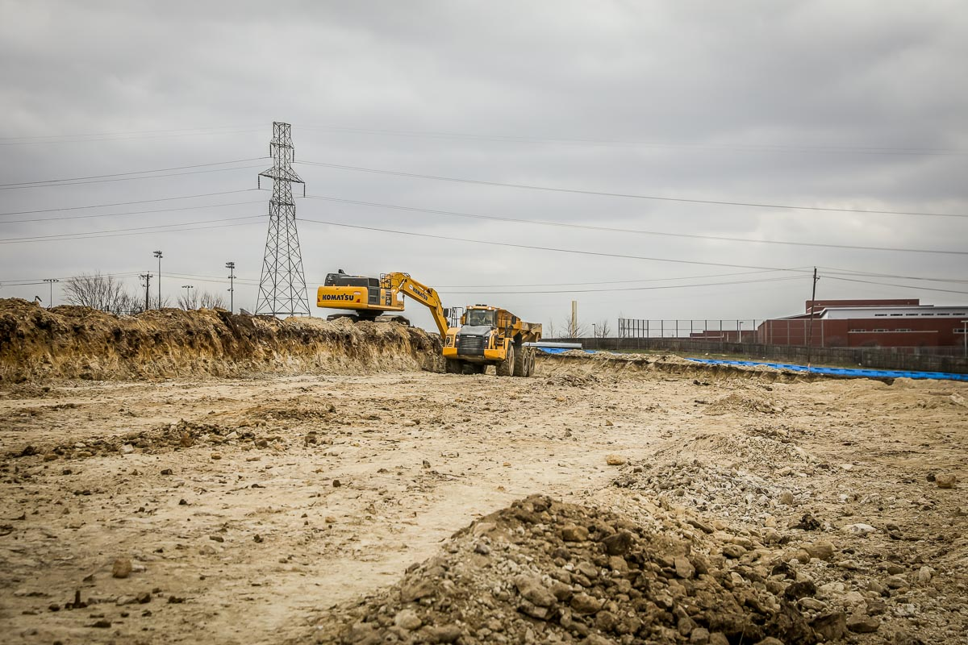
The building site is being excavated and prepped for piers.
The parking lot is being excavated and soil relocated on site.

Slide 3
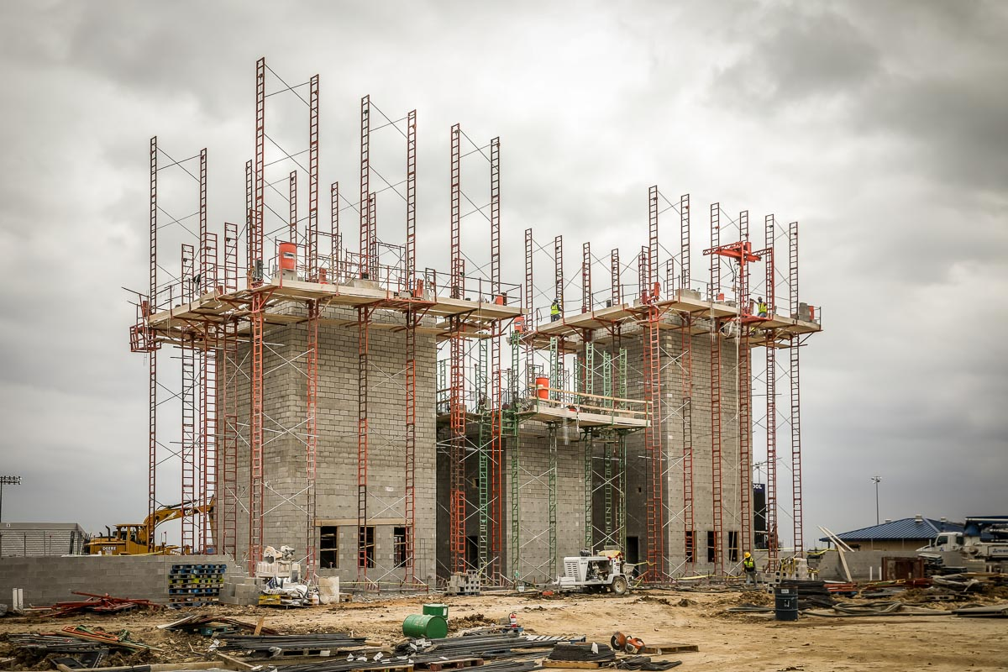
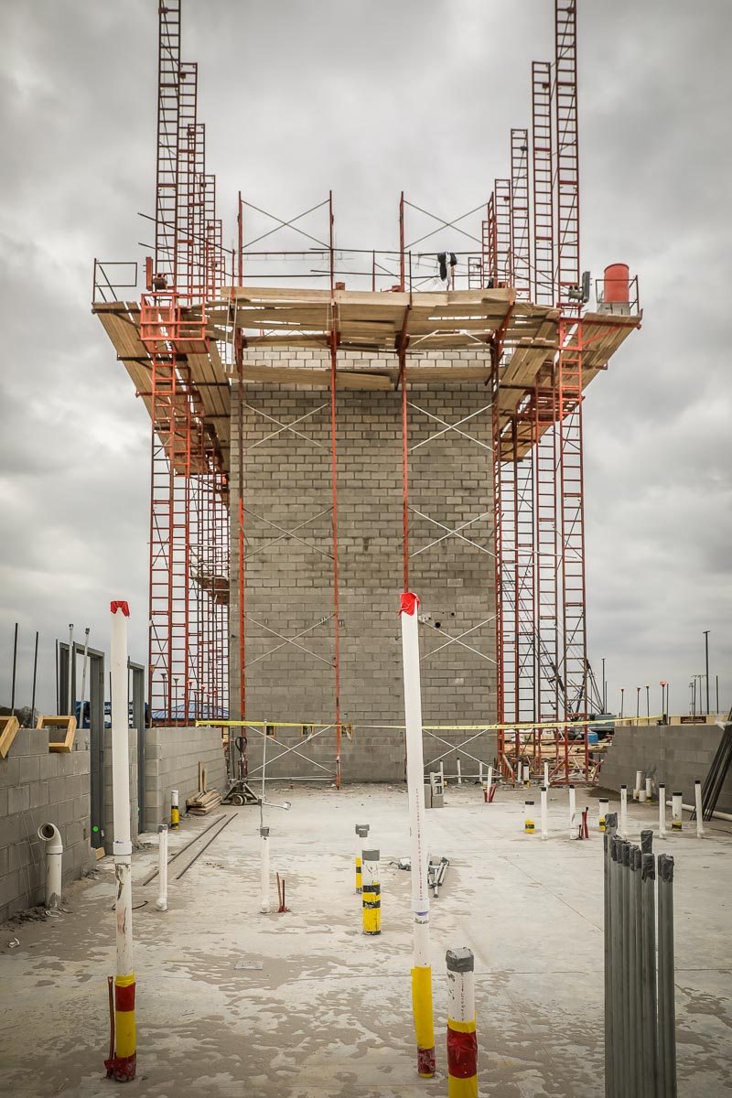
BOSWELL HS
The three towers of CMU block are going vertical up to 50 feet. The view on the left shows the rough-in plumbing for restrooms.

Slide 4
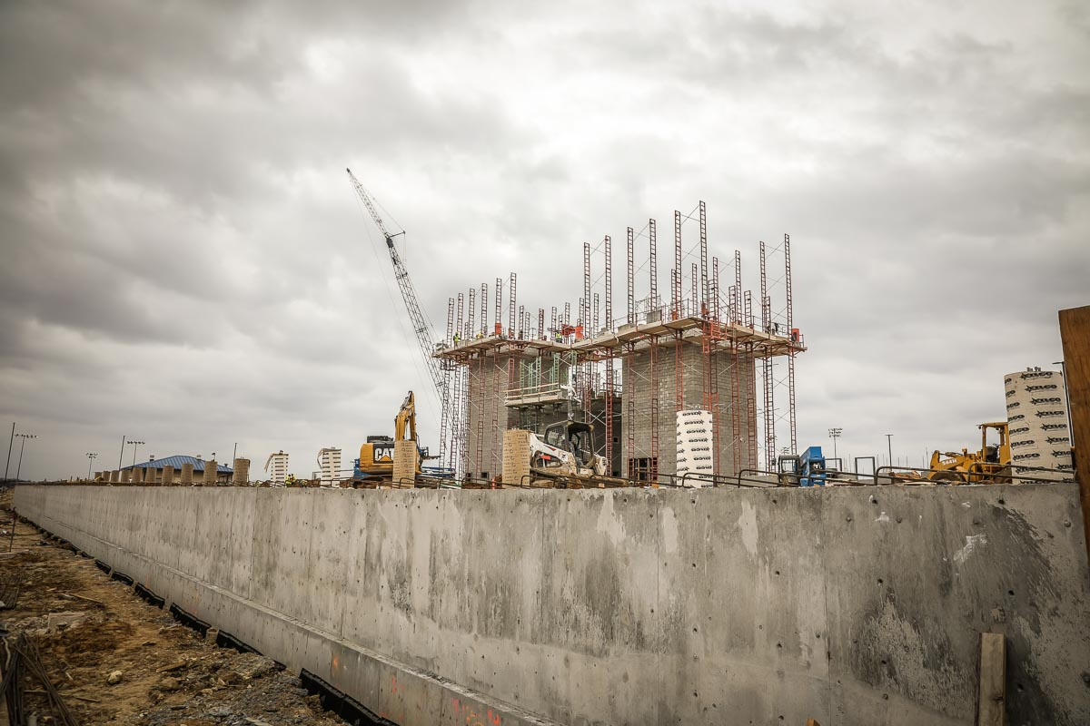
The view from the field shows the main retaining wall and pier casings that will support the structure on the home grandstands.

Slide 5
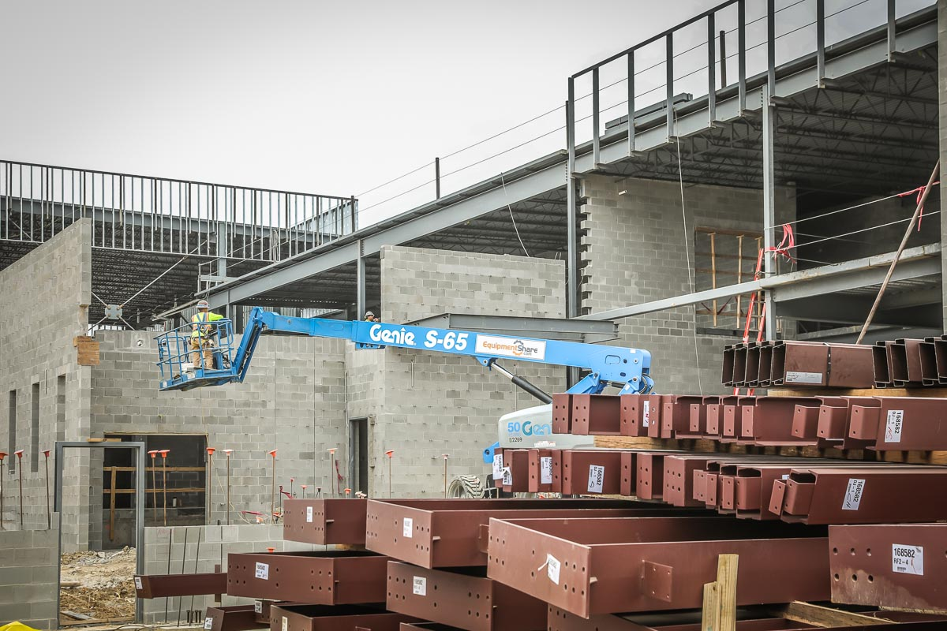
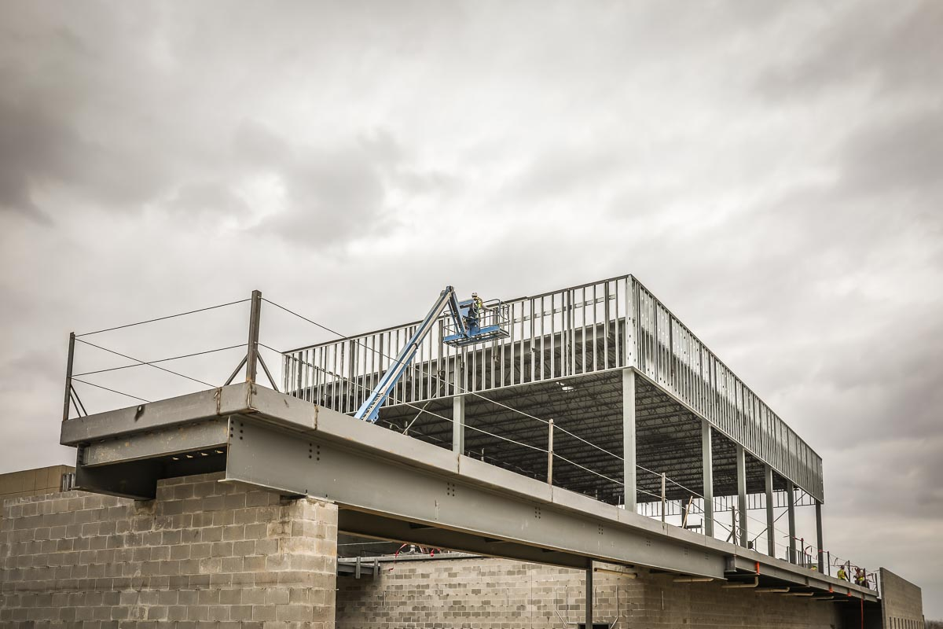
Photos show structural steel supports for the turf room and the weight room balcony.

Slide 6
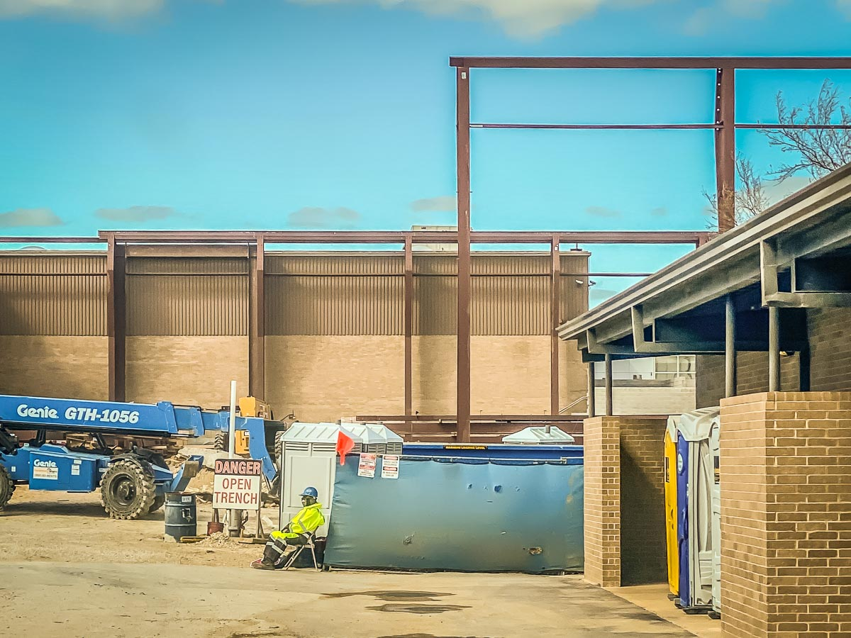
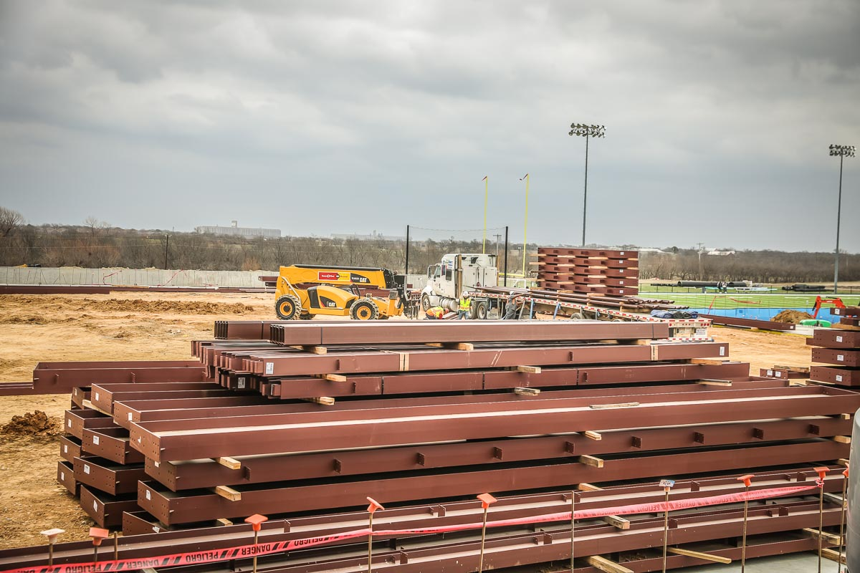
Installation of steel framing for the turf room is in progress.
More steel is being unloaded from the truck.

Slide 7
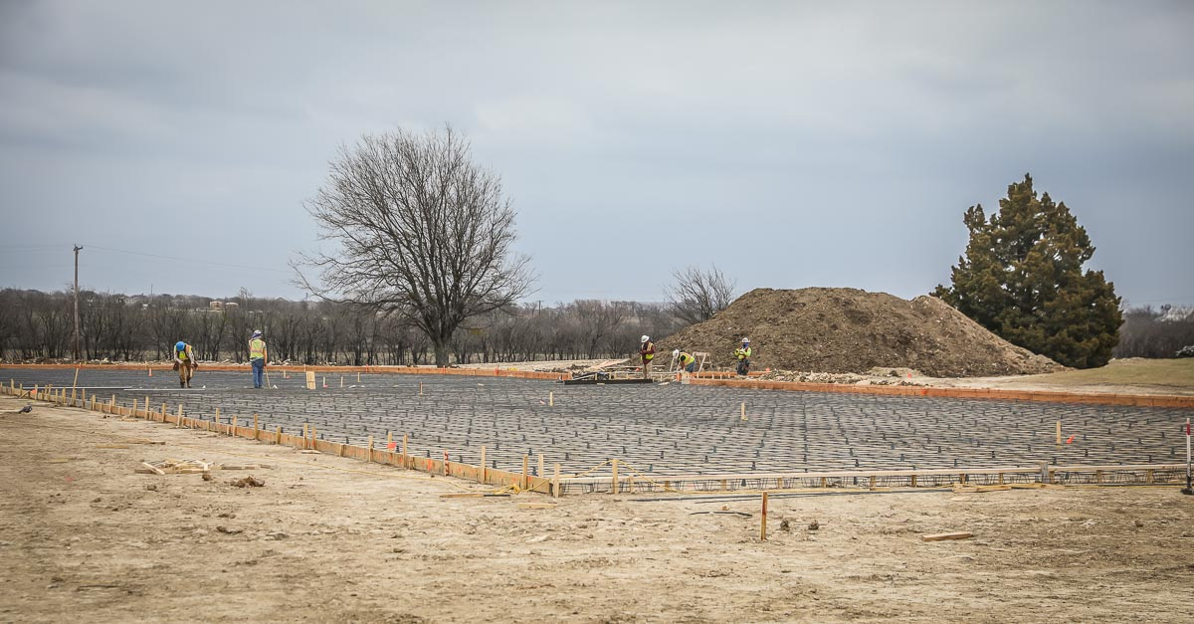
Workers are setting the forms and rebar for the bus loop south of the old turf room.

Slide 8
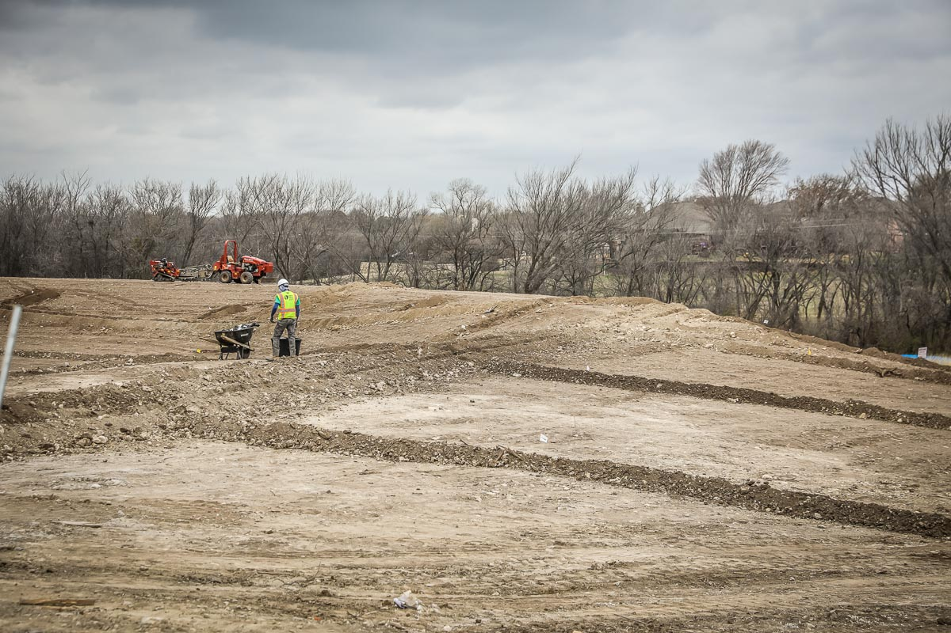
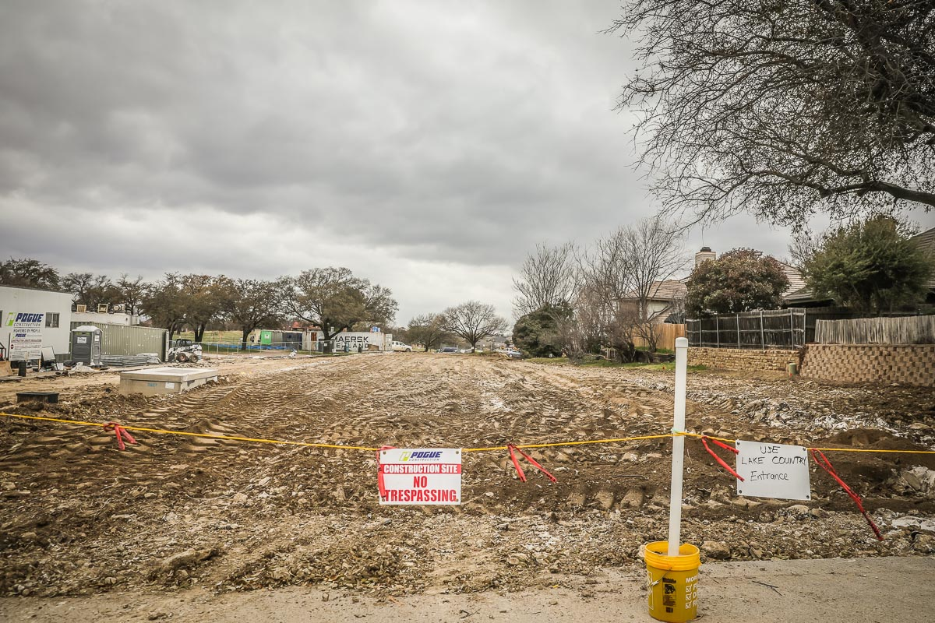
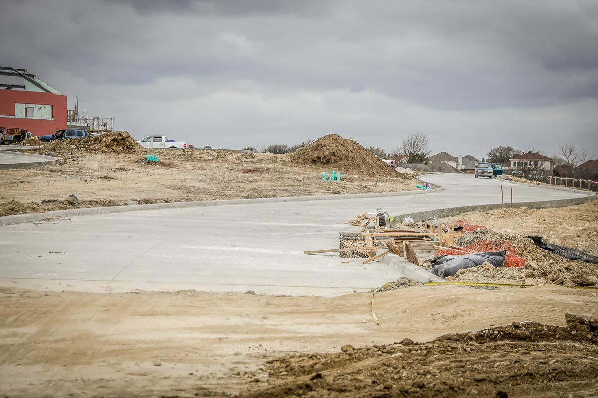
LAKE COUNTRY ES
Irrigation installation for the detention pond is in progress.
Parent drop-off on the north side of the building has been poured and tied in to the main entrance.
Prepping for the driveway entrance from Spring Street.

Slide 9
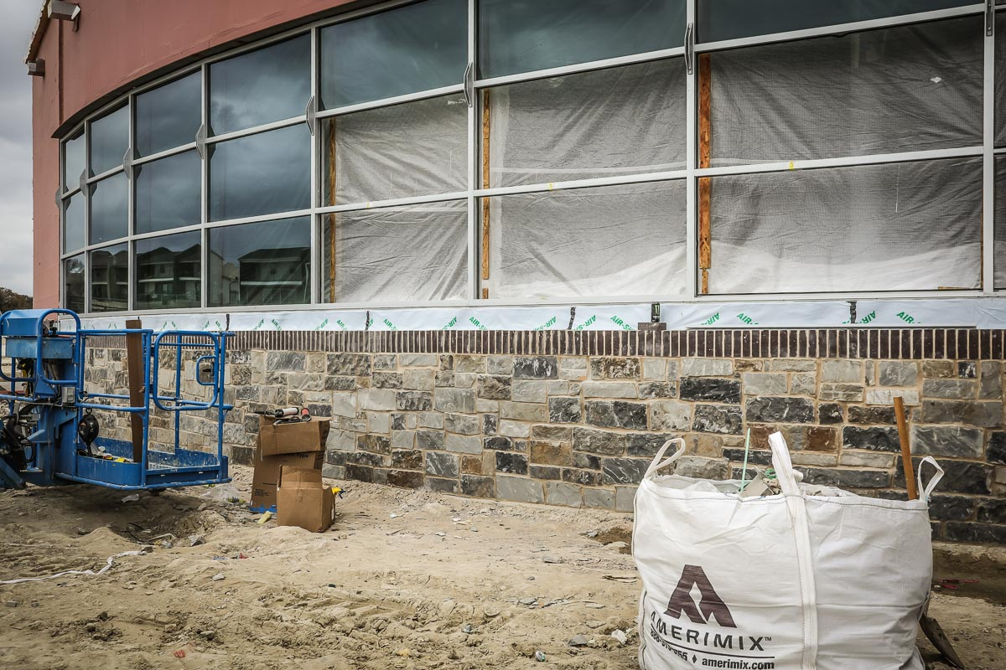
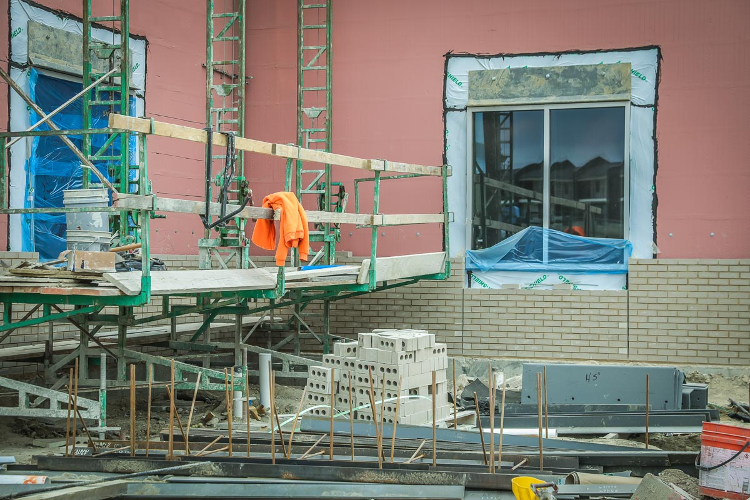
Stone and brick are being installed in the front of the building.

Slide 10
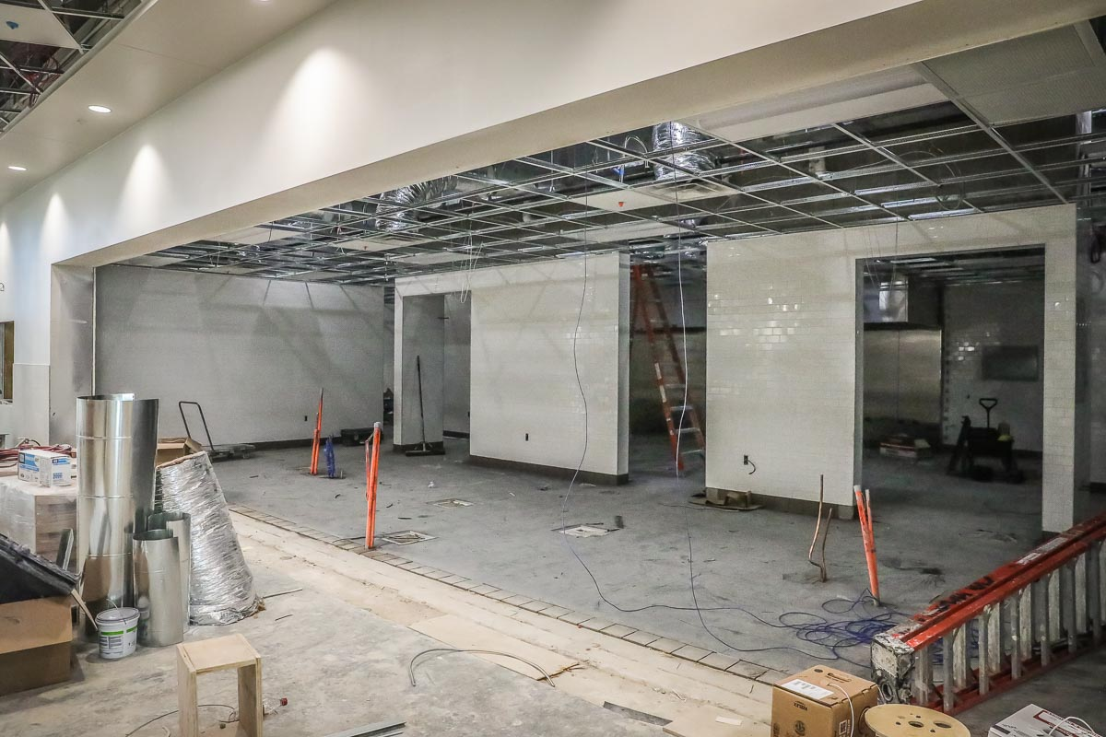
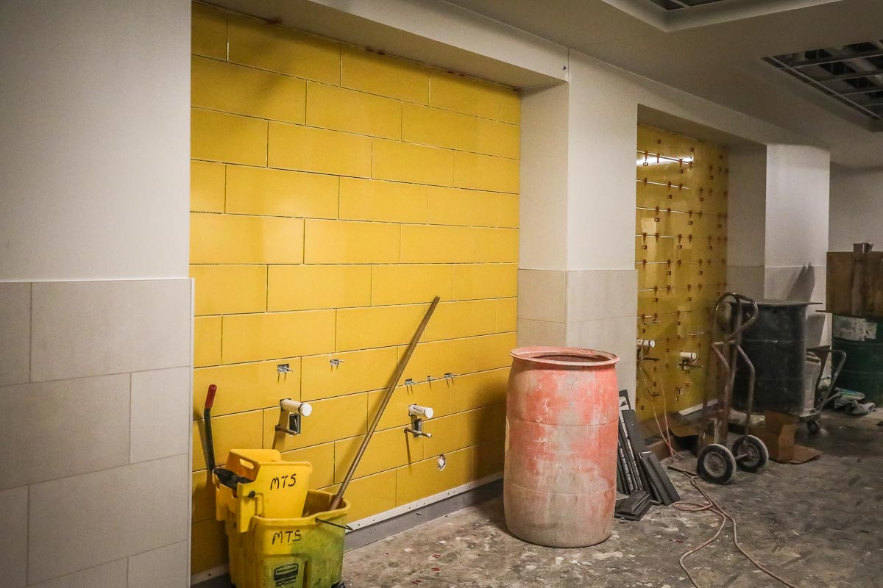
Tile installation of the wall tile in the gym/cafeteria hallway has been installed.
Wall tile, ceiling grid, and quarry tile have been completed in the kitchen area.

Slide 11
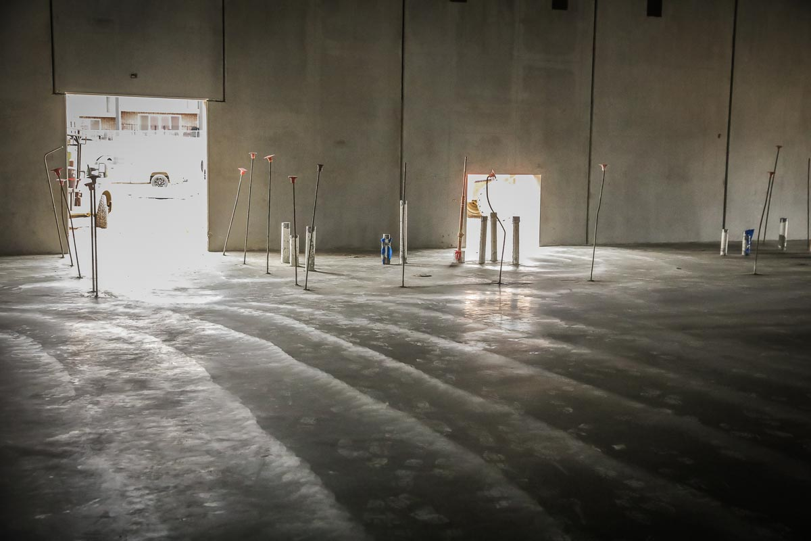
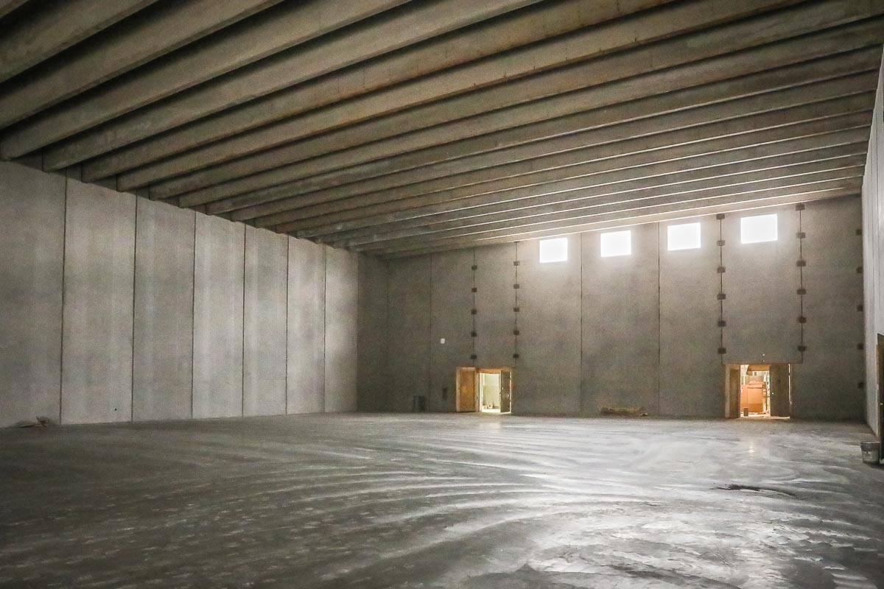
The gym floor and rough-in plumbing have been completed.

Slide 12
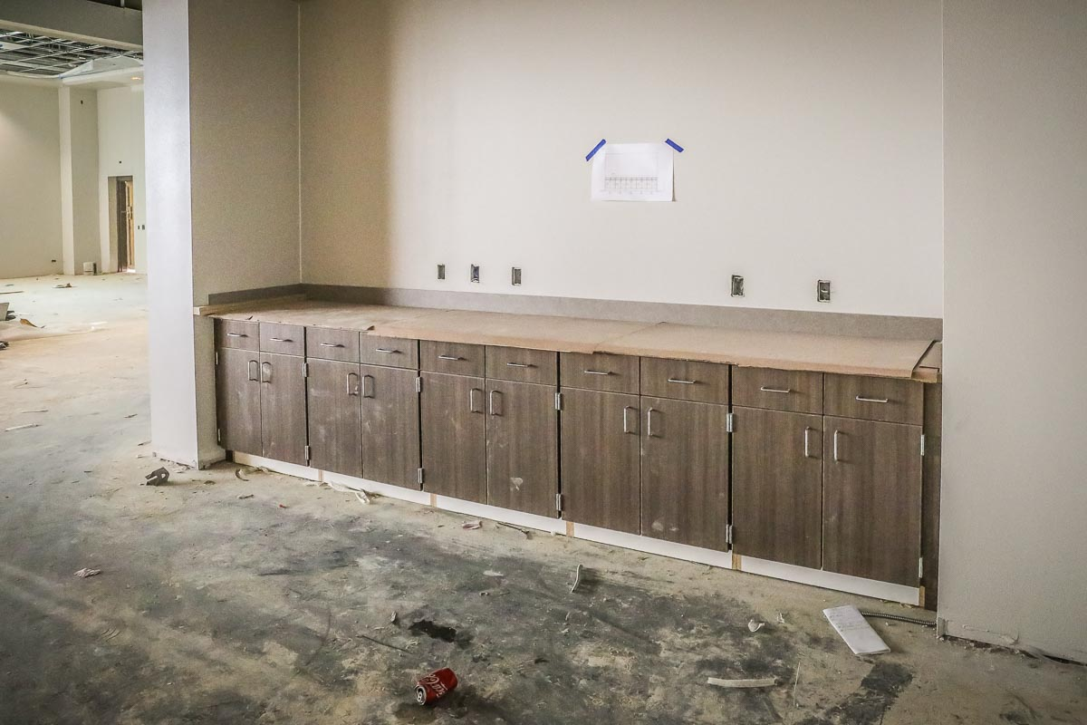
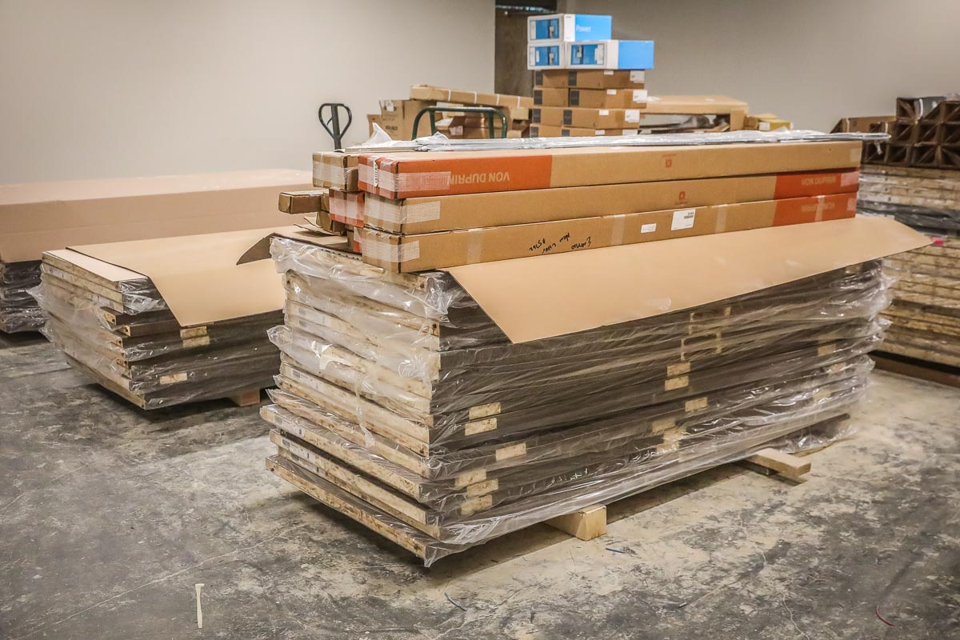
Cabinetry in the library has been installed along with delivery of the wooden doors.

Slide 13
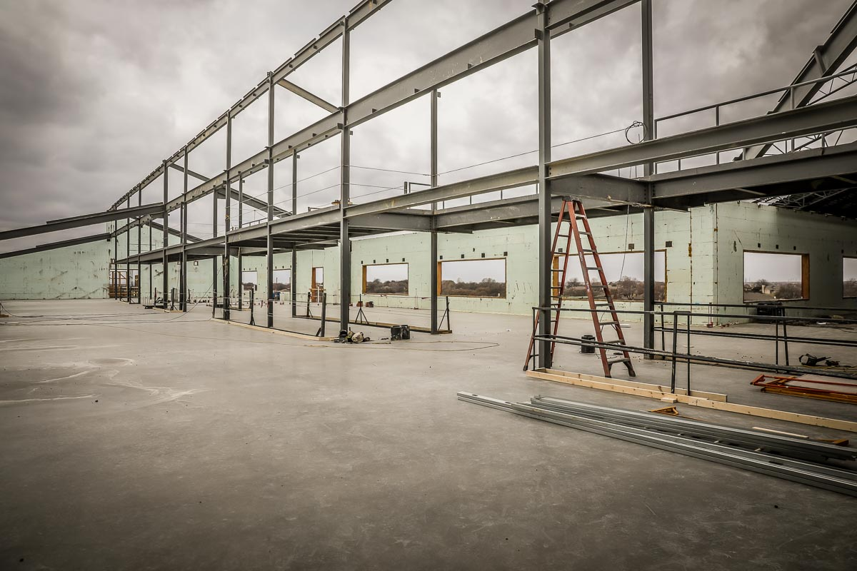
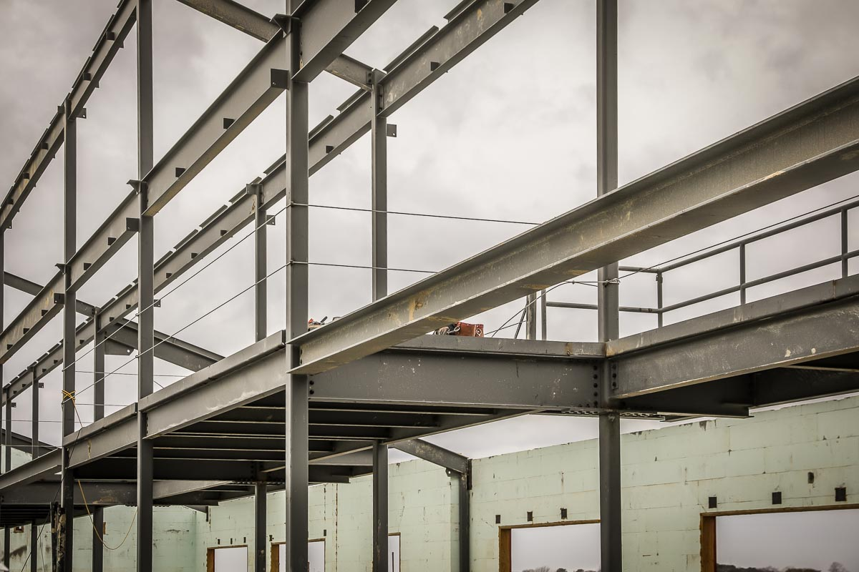
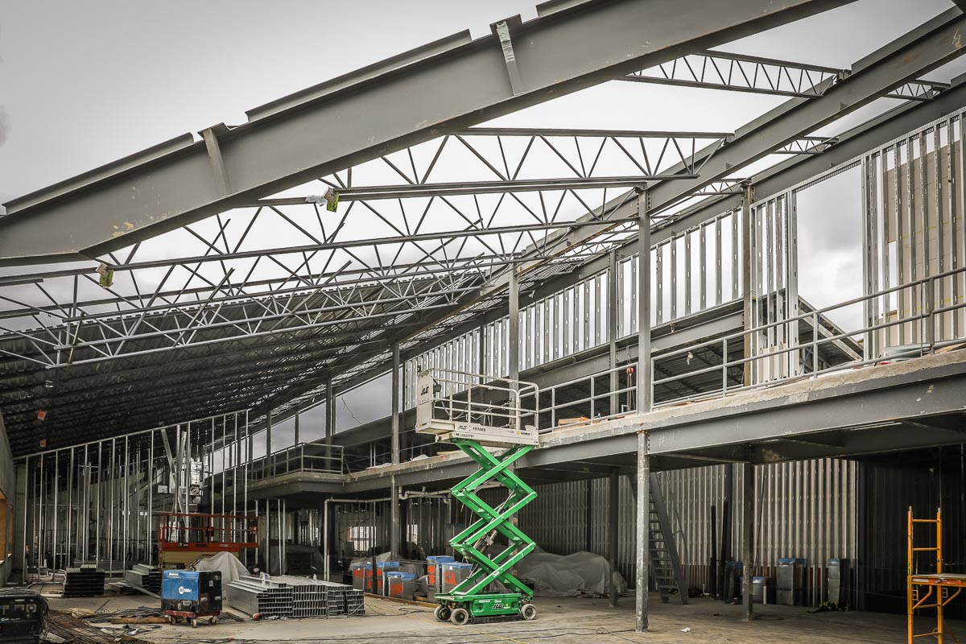
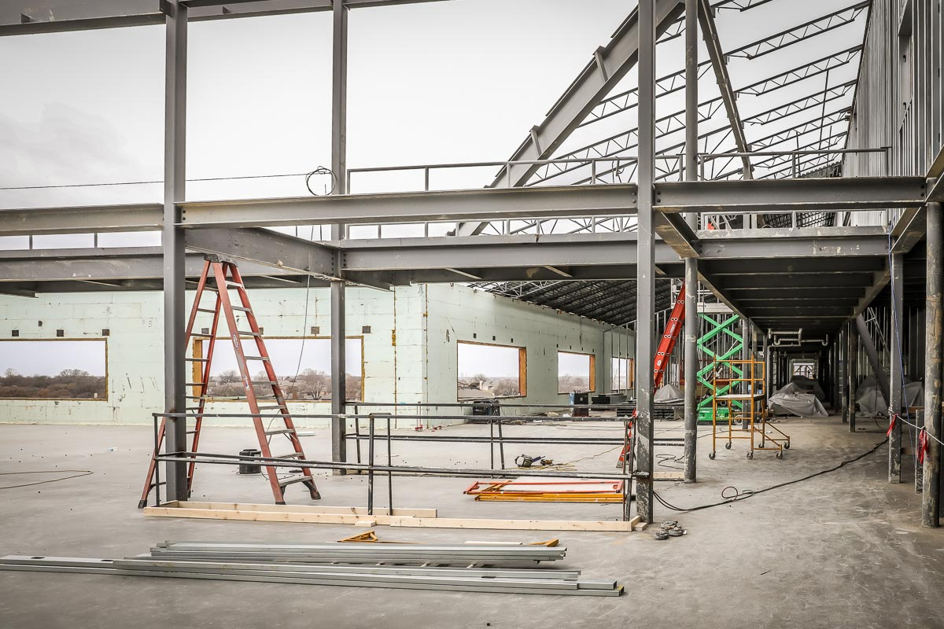
Photos show different stages of upstairs construction.

Slide 14
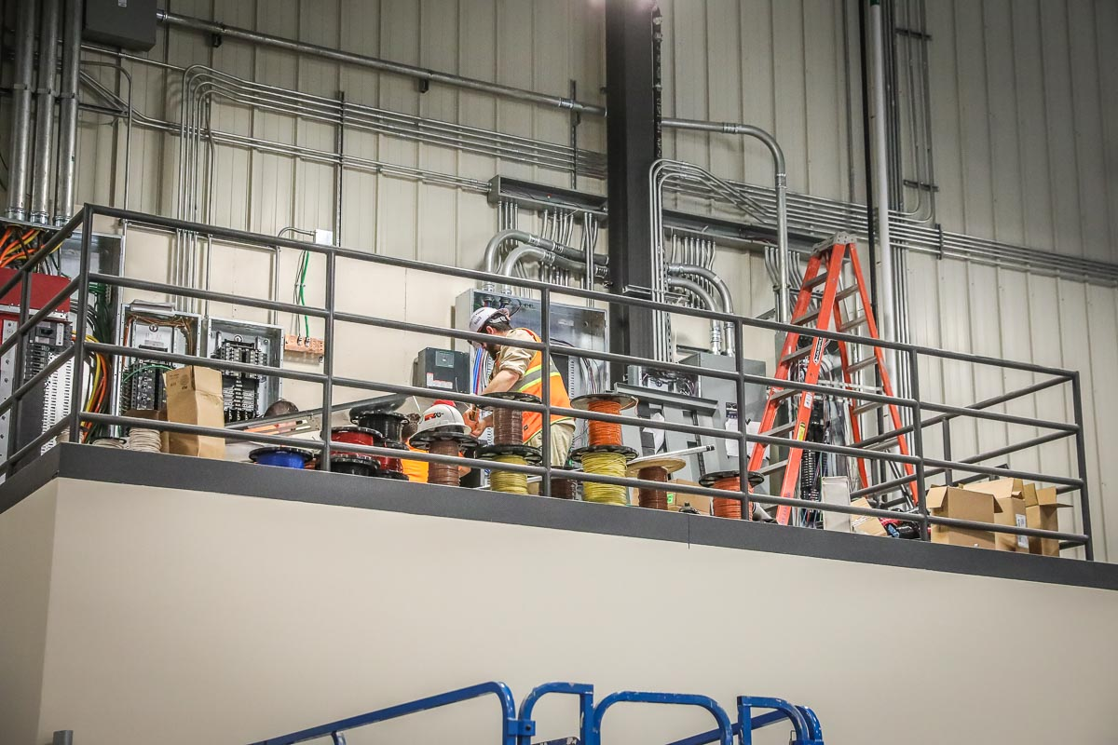
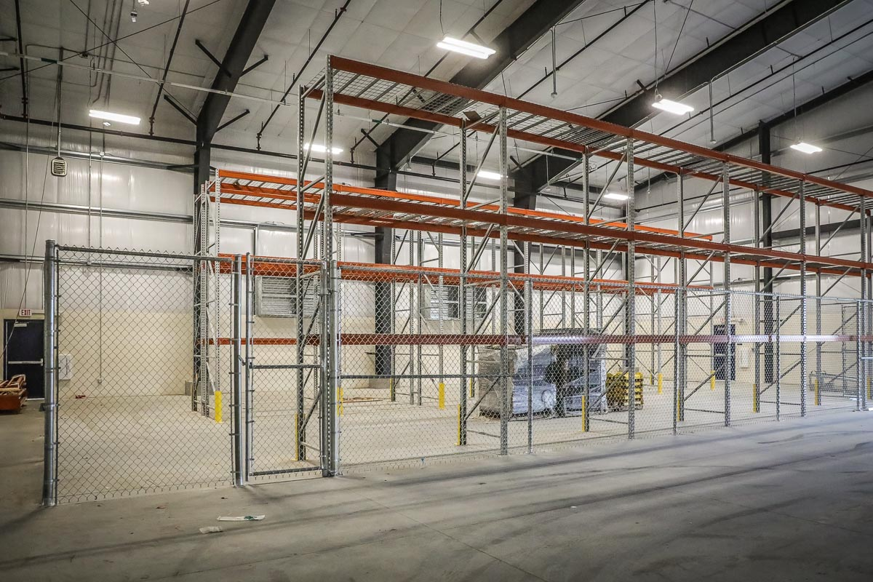
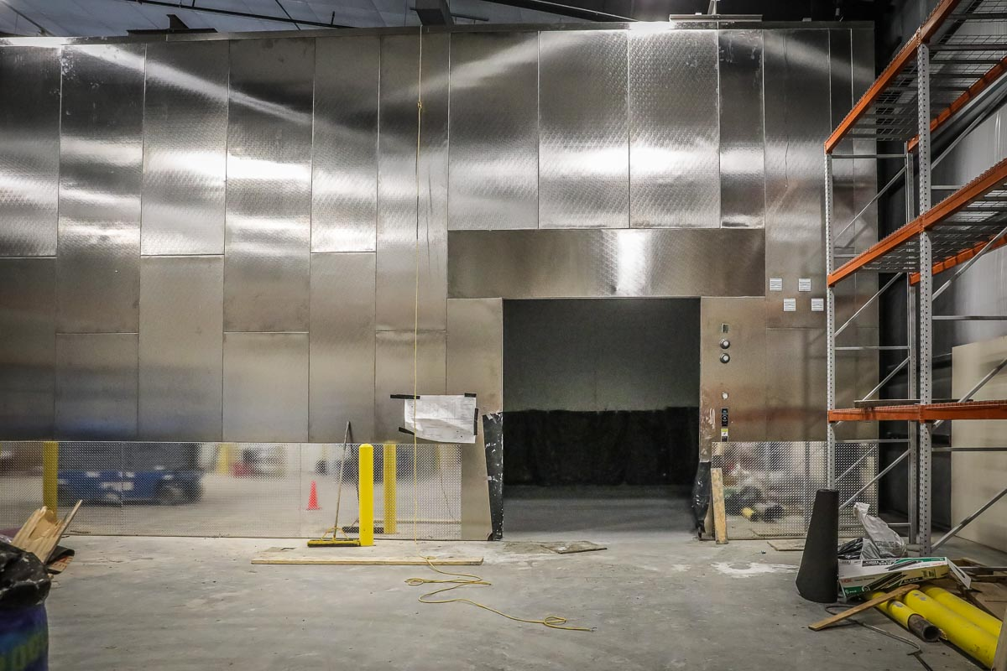
MAINTENANCE FACILITY
Substantial completion of the facility will be in April. Photos show the racks, electrical, and freezer.

Slide 15
PROGRESS UPDATE OF OTHER PROJECTS
Security Upgrades at Multiple Campuses and Jim Knight Maintenance Facility Additions and Renovations – Access control, storefront, and hardware have been completed at Bryson ES, Eagle Mountain ES, and Willow Creek ES, Wayside MS, Chisholm Trail HS, Saginaw HS, and Watson HS. Punch list and CO items will still be ongoing.
Wayside MS – VLK continues site development.

Slide 16
PROGRESS UPDATE OF OTHER PROJECTS
Eagle Mountain HS – VLK Architects will provide a presentation to the Board this evening. There are 10 steps that need to be completed before we can begin construction. Below is a list with approximate date of completion:
1. Drainage study – March 8
2. Water and sanitary sewer study – March 29
3. Preliminary plat – April 28
4. Traffic circulation study – June 28
5. Public improvement plans – June 29
6. Community facilities agreement – July 23
7. Construction of public improvements - August 27
8. Final plat – August 30
9. Addressing GIS – September 6
10. Building permit – September 7

